Slide 1
CNC Drawing Machine
Myo Myo Khant

Slide 2
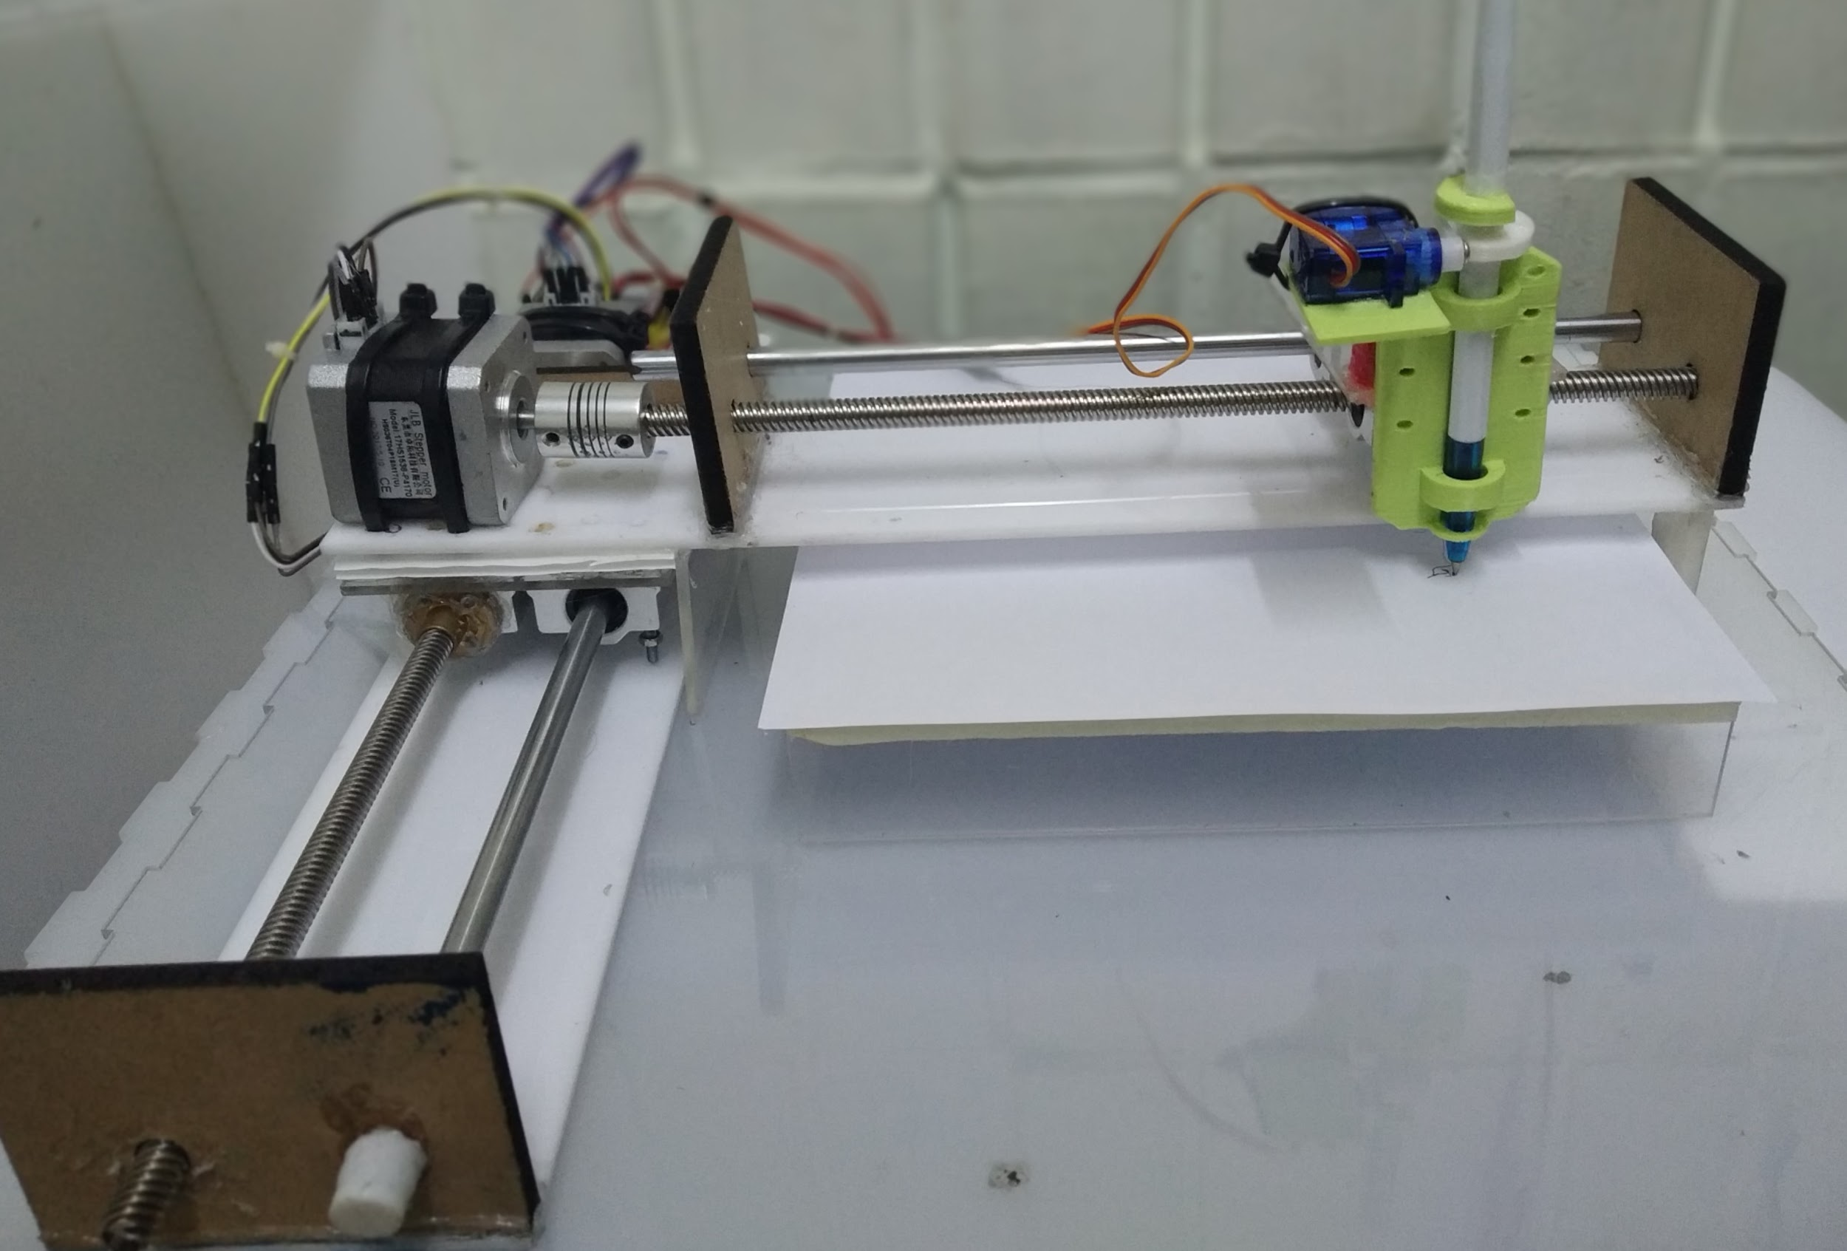
Hardware Of Drawing Machine

Slide 3
About Drawing machine
Simple, modern, and precise pen plotter.
Can draw text or pictures on almost any flat surface.
Mainly for students who want to save money and to draw,create design or something without using printer.
Moreover,this machine can be used as signature machine ,digital artists, who want to plot their artworks,etc.

Slide 4
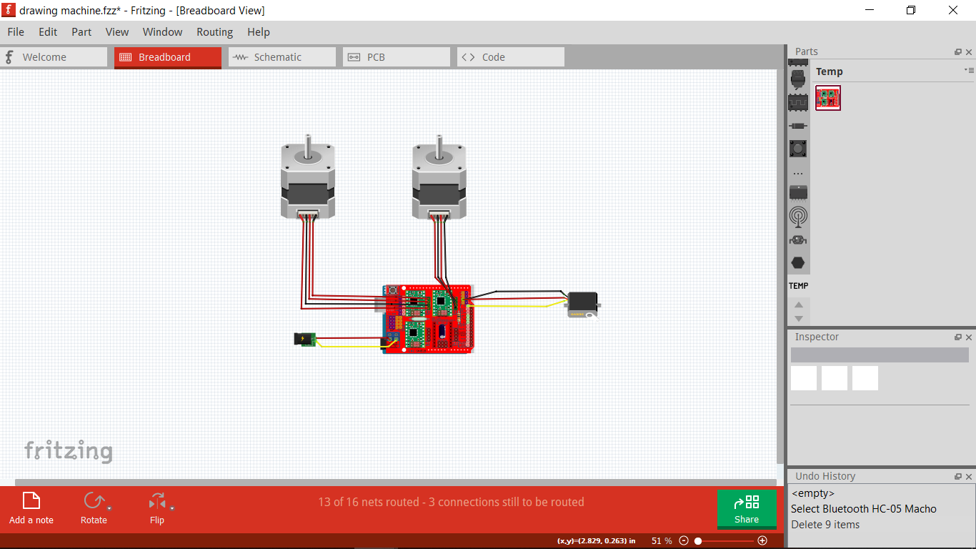
Circuit Diagram Of Drawing Machine

Slide 5
Components
Nema 17 Hybrid Stepper Motors
Servo motor SG-90
A4988 CNC shield V3 for 3D printer
A4988 Stepper motor drivers
8mm x 180 mm Threaded rod
8mm x 180 mm Smooth rod
Arduino Uno
Nuts,Coupling,Linear bearing sliders
12V battery
3D printed parts

Slide 6



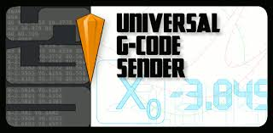
How to Use
Interpret a picture to gcode using Inskcape software.
Then send this gcode to drawing machine using Universal Gcode Sender.

Slide 7
Topics about Learning From Making Drawing Machine
How gcode commands work with stepper motor.
How to move x,y,z directions with motors.
About grbl firmware
Drawing 3D design
Mechanical design
This drawing machine ‘s functions are approximately equal to laser cutters,3D printers and CNC routers.I have known their functions and I may be familiar their functions when I make them later.

Slide 8
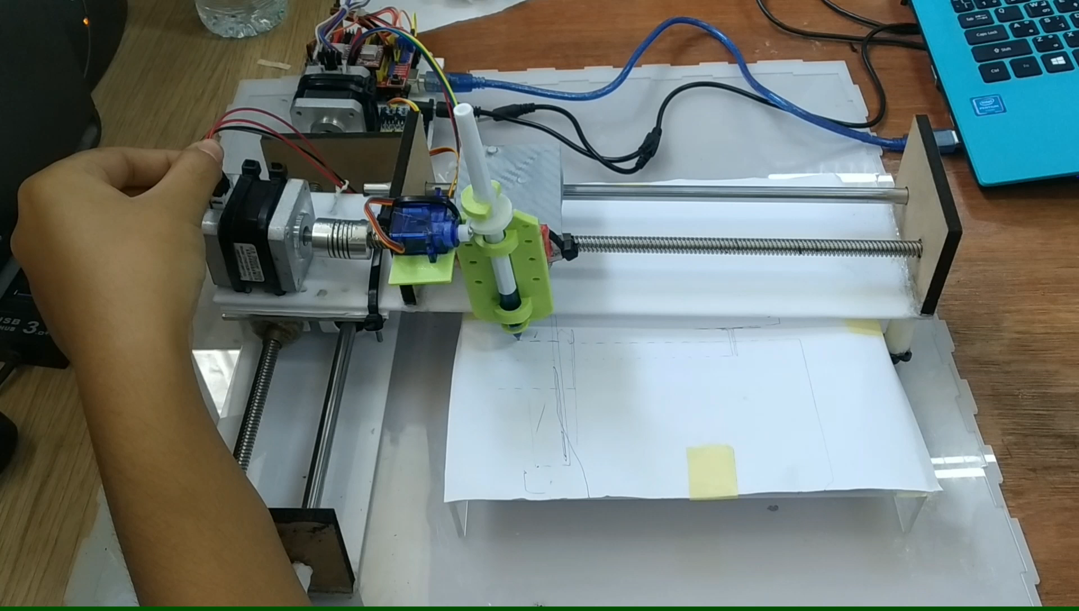
Movements With Machine Control

Slide 9
Questions & Answers
Thank You!

